Slide 1



Slide 2


Fake News Detection Using AI

Slide 3

Group Members Introduction
Muhammad Tayyar Hussain
BC220201723

Slide 4
INTRODUCTION OF PROJECT
In this vast, digital, and interconnected world, fake news has become a significant issue, spreading misinformation and influencing public opinion, and sometimes it can create unnecessary panic in society, which is a very serious issue.
This project demonstrates the integration of Web Development and Artificial Intelligence (ML) to address a real-world problem.
These slides provide the details of the system design, implementation, and functionality developed as part of the Final Year Project.

Slide 5
Problem Statement
Rapid spread of fake news on social media platforms.
Difficult and time consuming to manually verify authenticity of news articles.
Fake news affects public opinion and create panic in the society.
Need a automated detection system for the fake news.

Slide 6
Key Features of the System
Fake News Detection using AI
News Prediction with Confidence Score.
User News Analyzed History Tracking.
Graphical View of Analyzed News Article (Chart).
Admin Uploads New Dataset and Retrain the Machine Learning Algorithm.
Model Rollback Feature (in case of poor retraining!).

Slide 7
Core Development Tools
Python 3.x
WELFake Dataset and FakeNewsNet Dataset
Django
Jupyter Notebook
VS Code
SQLite
Pandas
Scikit-Learn
Chart.js

Slide 8
The system is designed with two roles: User and Admin.
Users can register or log in to the system, submit news headlines or article content for analysis, and view their previous prediction history.
Admin is responsible for managing user accounts, uploading and updating datasets, retraining the machine learning model, monitoring system performance through metrics such as accuracy, precision, recall, and F1-score, and managing stored user data.

Slide 9
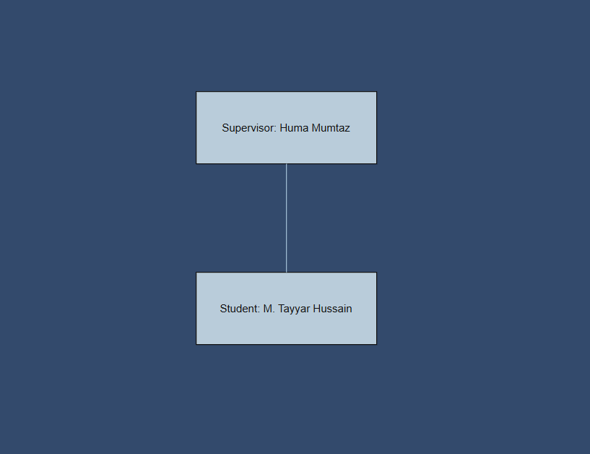
Team Structure

Slide 10
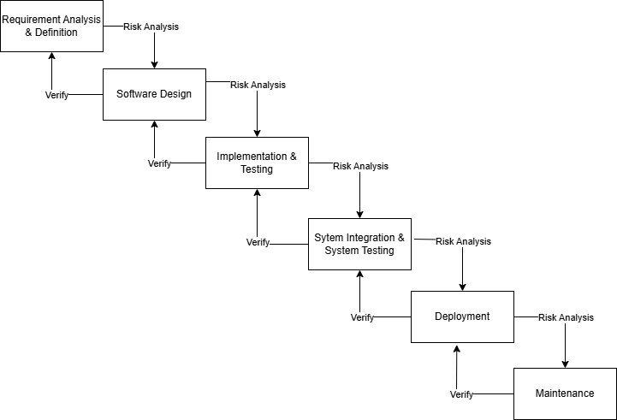
Diagram of VU Process Model.

Slide 11
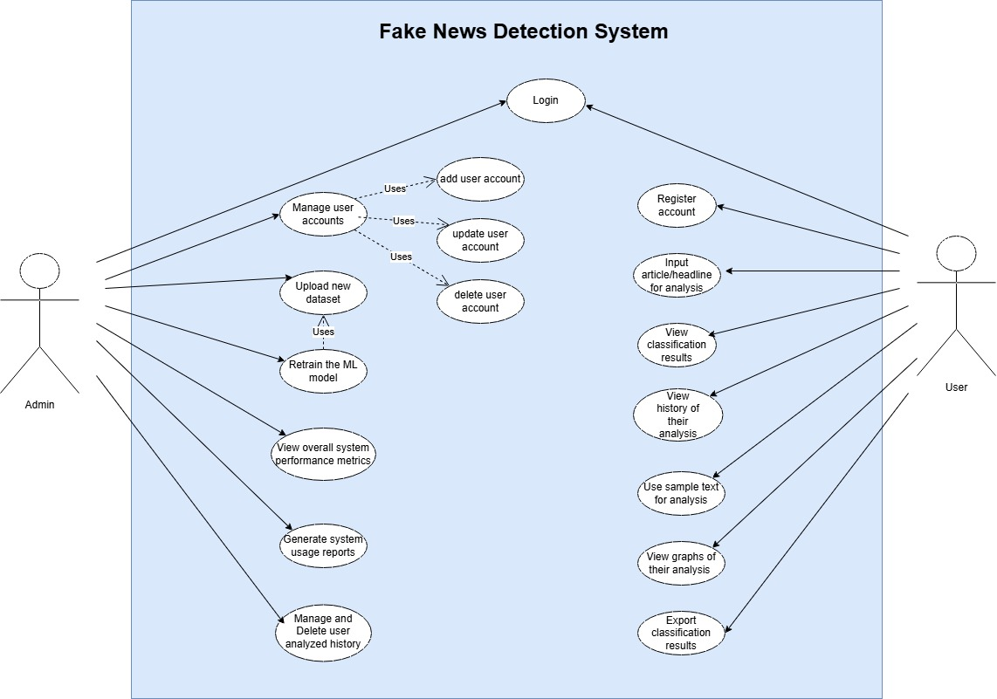
Use Case Diagram

Slide 12
Business Rules Catalog
Functional Requirements:
Admin Panel Features:
The system shall allow access to the admin panel only to those with the correct administrative credentials in order to access the admin panel features.
The system shall allow the admin to manage user accounts, such as add, update, and delete user accounts.
The system shall allow the admin to upload new training datasets in CSV format only and update existing datasets with a newly uploaded dataset.
The system shall allow the admin to retrain the ML model using uploaded datasets.
The system shall allow the admin to view system performance metrics such as accuracy, precision, recall, and F1-score after model training is completed.
The system shall allow the admin to generate usage reports, such as the number of analyses done per day, and export them in CSV format.
The system shall allow the admin to view, manage, or delete the selected or all the history of analyzed articles.
To ensure data security and privacy, the system shall ensure that only an admin can access the admin panel, and users' passwords will be hashed.

Slide 13
Business Rules Catalog
Functional Requirements:
User Panel Features:
The system shall allow the user to register a new account with a unique username, and the password must be greater than 8 characters and contain at least one special character, or the admin can manually register (add) the user in the system.
The system shall allow the user to log in securely using their credentials after registration.
The system shall provide an interface that allows the user to input news articles or headlines for analysis.
The system shall provide the user with the result as Real or Fake after the input of new articles or headlines, and receive classification results with a confidence score.
The system shall allow the user to view their previously analyzed articles or headlines in history.
The system shall allow the user to test the system using the sample datasets/text (some articles or headlines as text, not in CSV format). This sample will also be provided to the user by the system.
The system shall allow the user to view results of the analysis, either Real or Fake, in graphical form (charts, graphs).
The system shall allow the user to export the results of their analysis in CSV or Excel format.
The system shall display error messages if input is invalid or unsupported, which could result from invalid language entered or if the input text is very short, less than the minimum length.

Slide 14
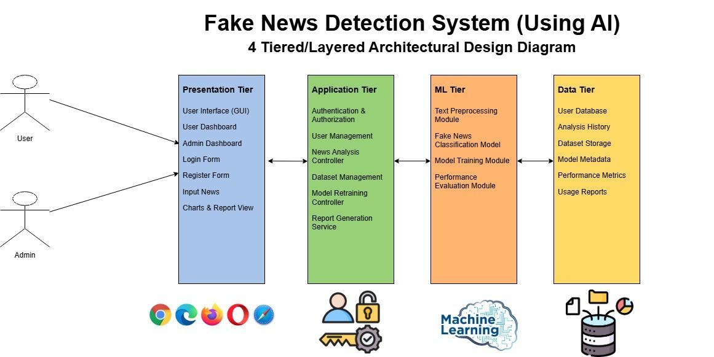
Architectural Design

Slide 15
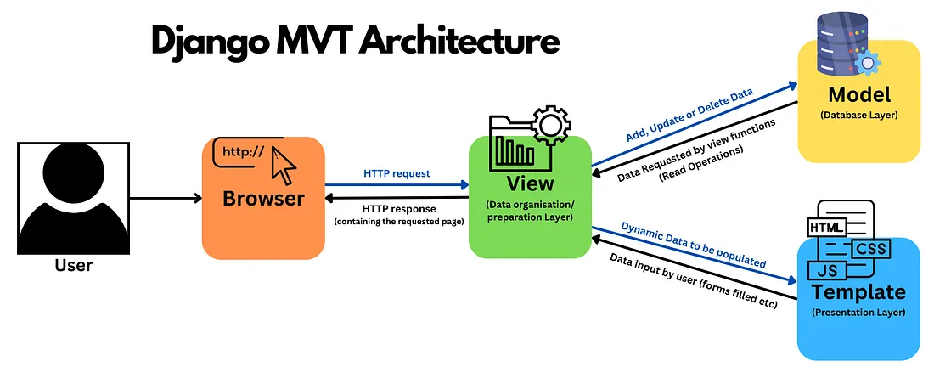
Django Web App Framework
For the Web interface for the ML model Django framework is selected.
Provides Low Coupling and High Cohesion.

Slide 16
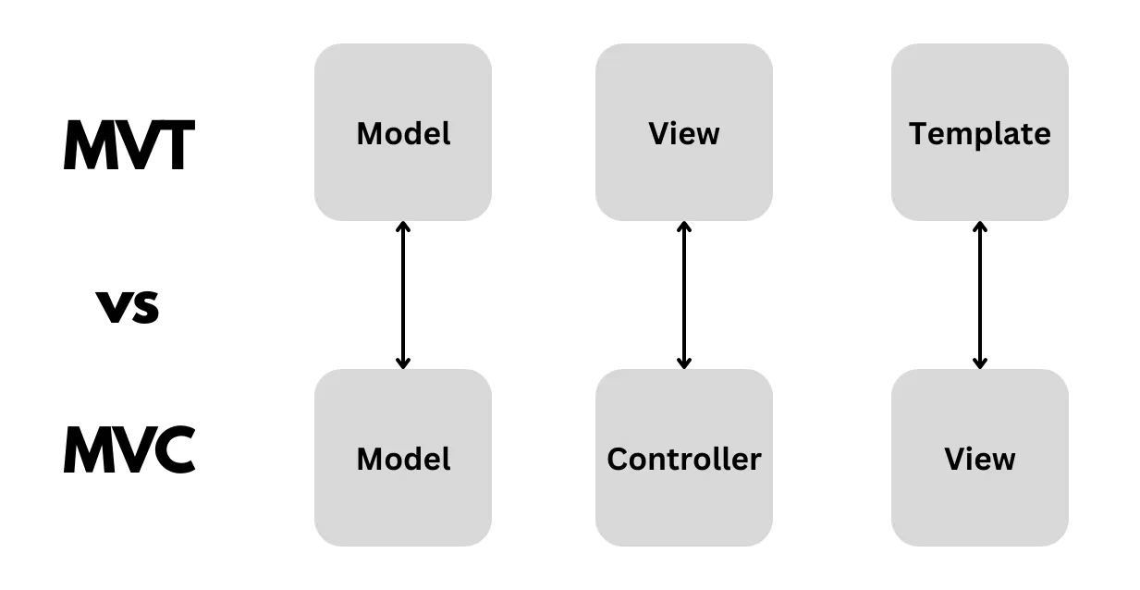
Django’s MVT vs Tradional MVC
For the Web interface for the machine learning model Django Framework is

Slide 17
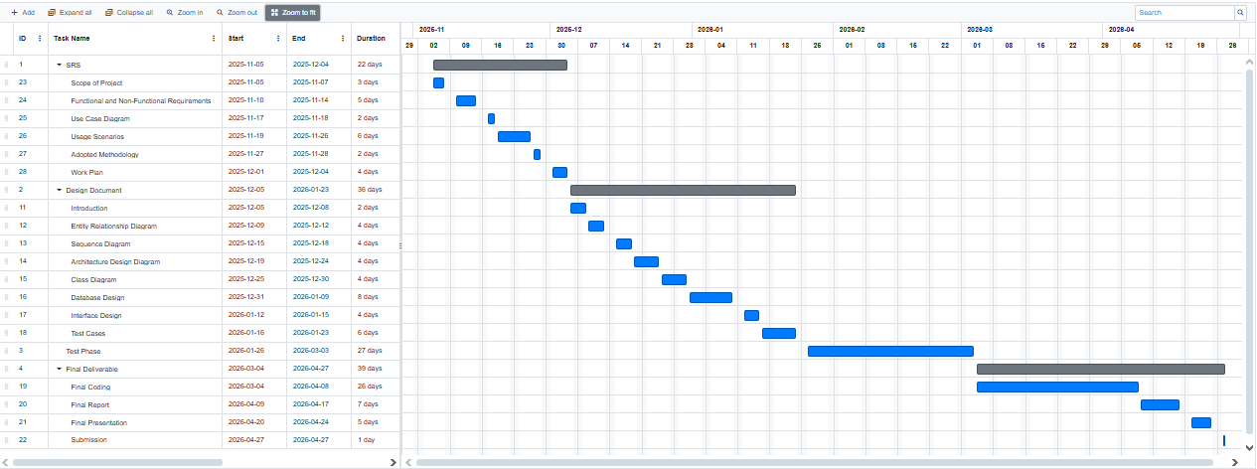
Project Schedule
Gantt Chart

Slide 18
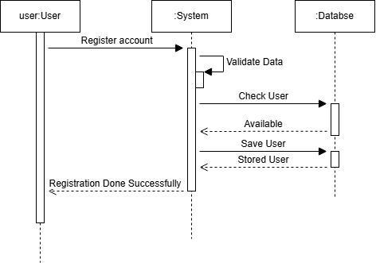
Sequence Diagrams
Sequence diagram of UC-07 Register

Slide 19
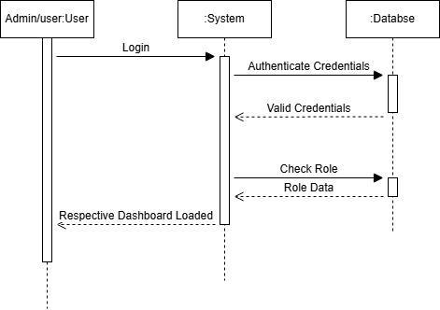
Sequence Diagrams
Sequence diagram of UC-08 Login

Slide 20
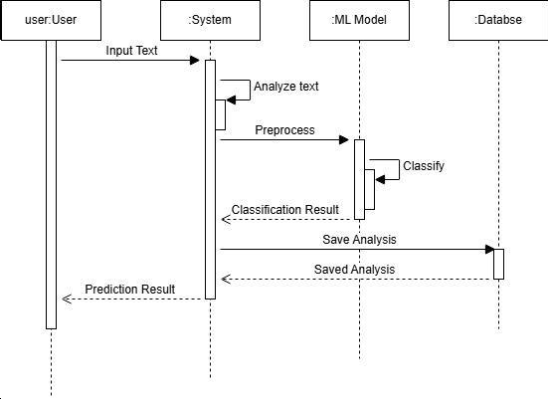
Sequence Diagrams
Sequence diagram of UC-09 Input article/headline for analysis

Slide 21
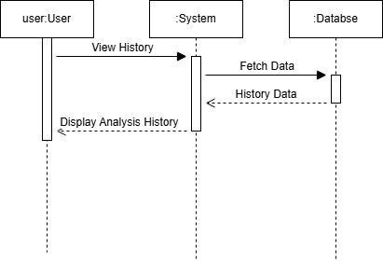
Sequence Diagrams
Sequence diagram of UC-11 View history of their analysis

Slide 22
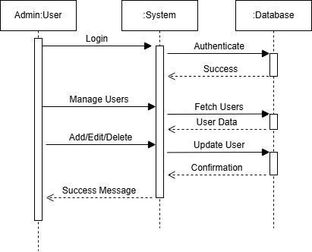
Sequence Diagrams
Sequence diagram of UC-01 Manage user accounts

Slide 23
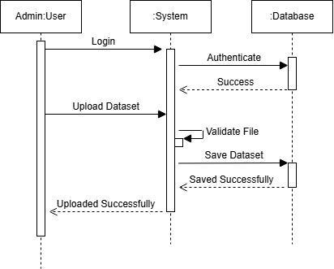
Sequence Diagrams
Sequence diagram UC-02 Upload new dataset

Slide 24
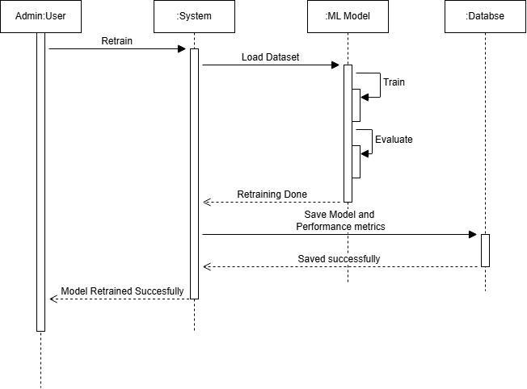
Sequence Diagrams
Sequence diagram of UC-03 Retrain the ML model

Slide 25
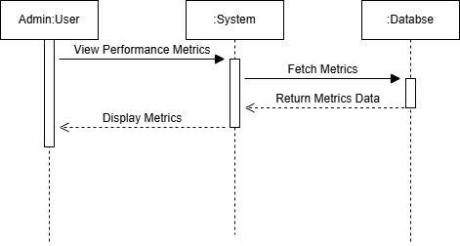
Sequence Diagrams
Sequence diagram of UC-04 View overall system performance metrics

Slide 26
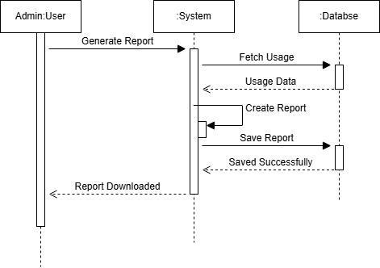
Sequence Diagrams
Sequence diagram of UC-05 Generate system usage reports

Slide 27
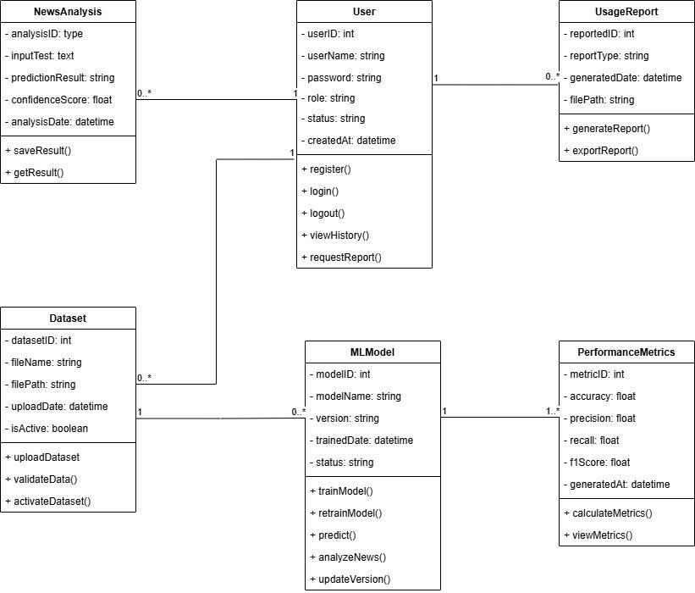
Logical Model/Class Diagram

Slide 28
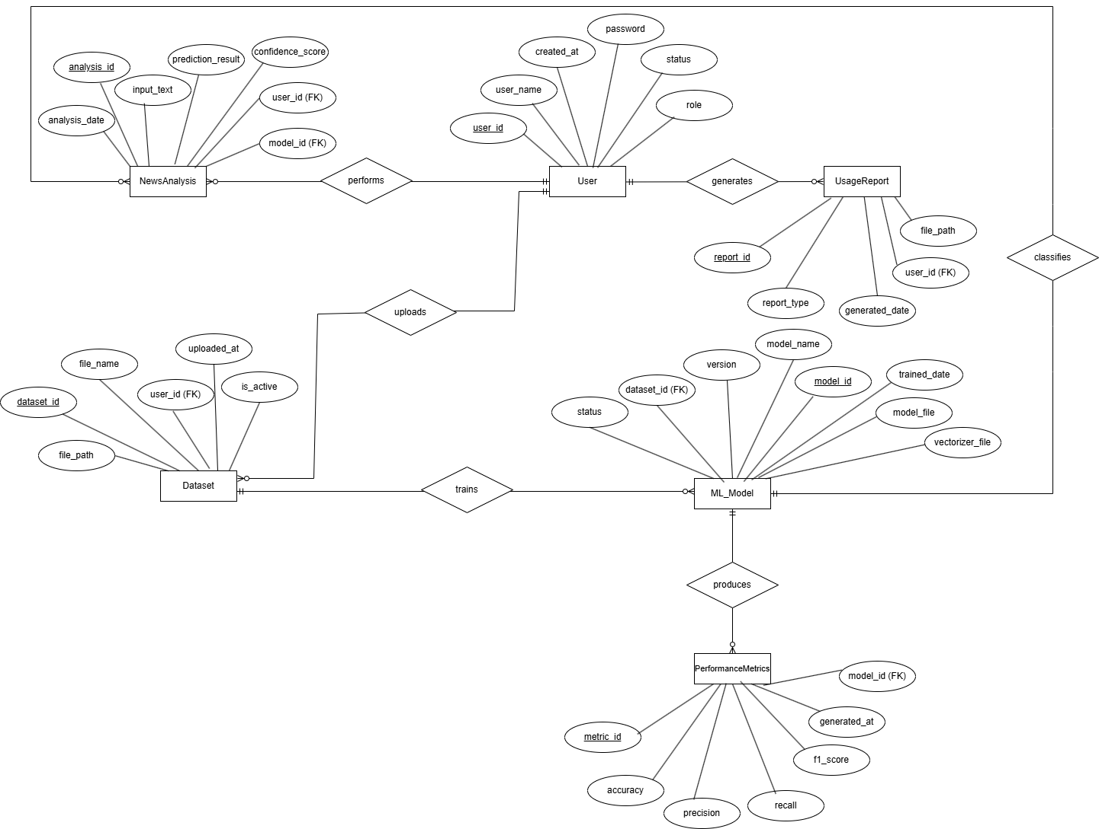
Entity-Relationship Diagram

Slide 29
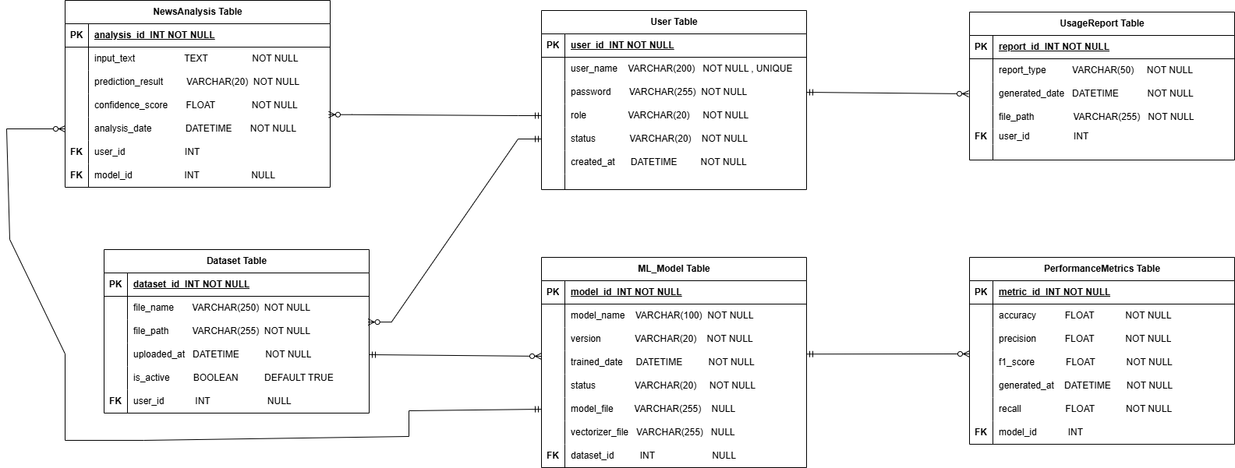
Database Diagram

Slide 30
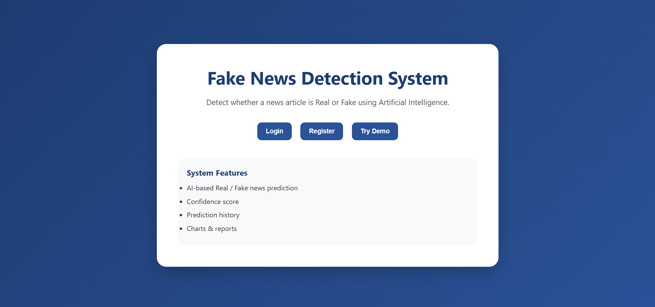
User Interfaces
Landing Page

Slide 31
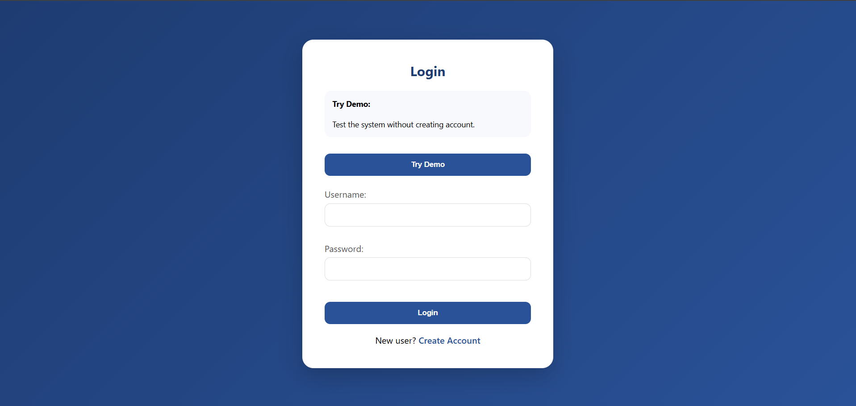
User Interfaces
Login Page

Slide 32
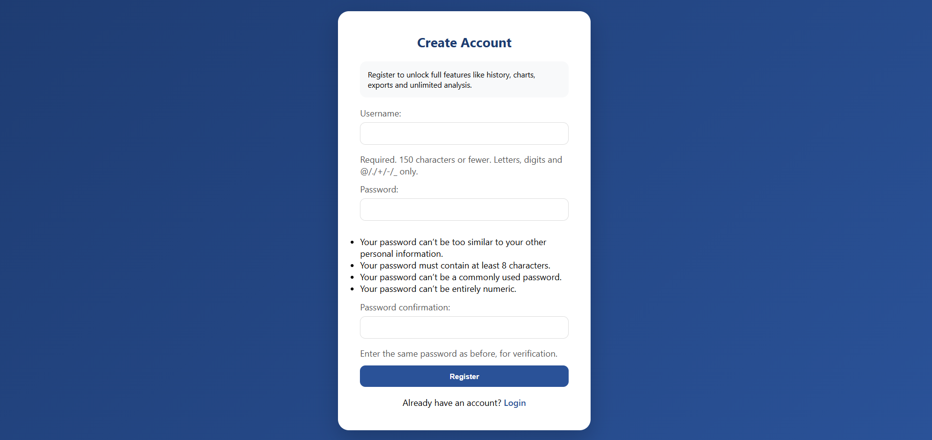
User Interfaces
Registration Page

Slide 33
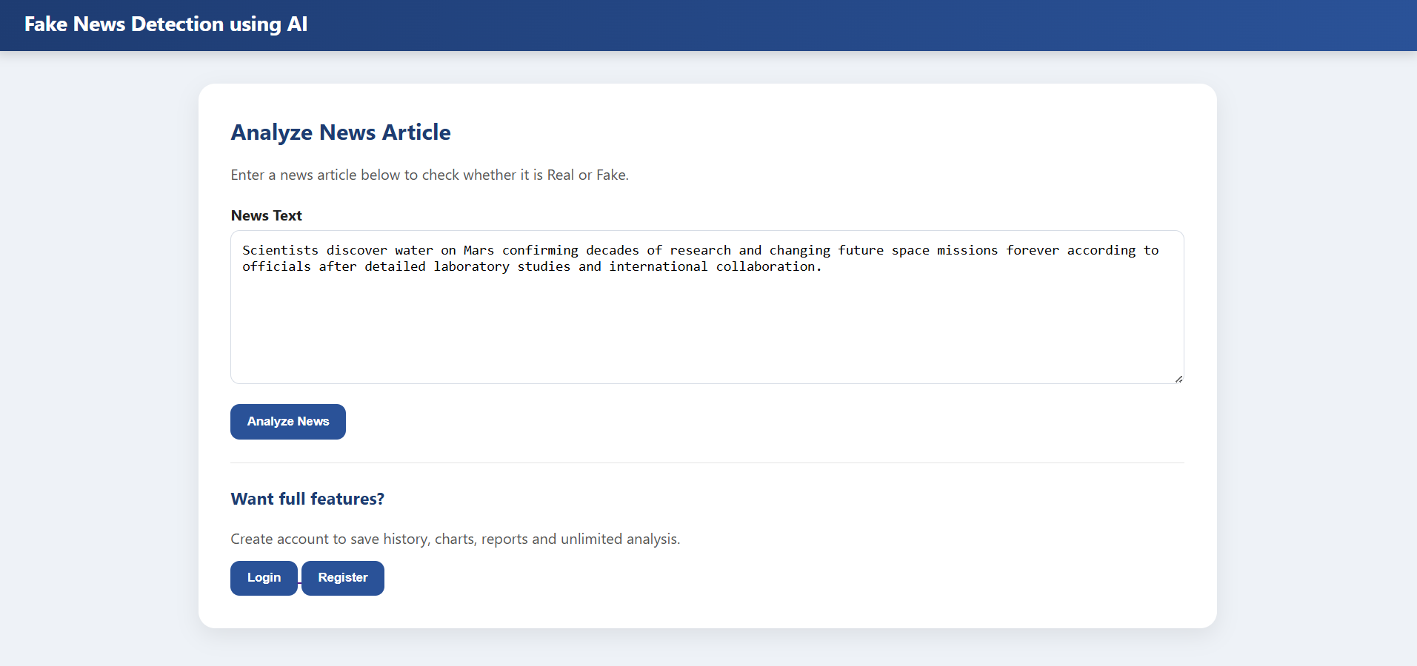
User Interfaces
Try Demo Page

Slide 34
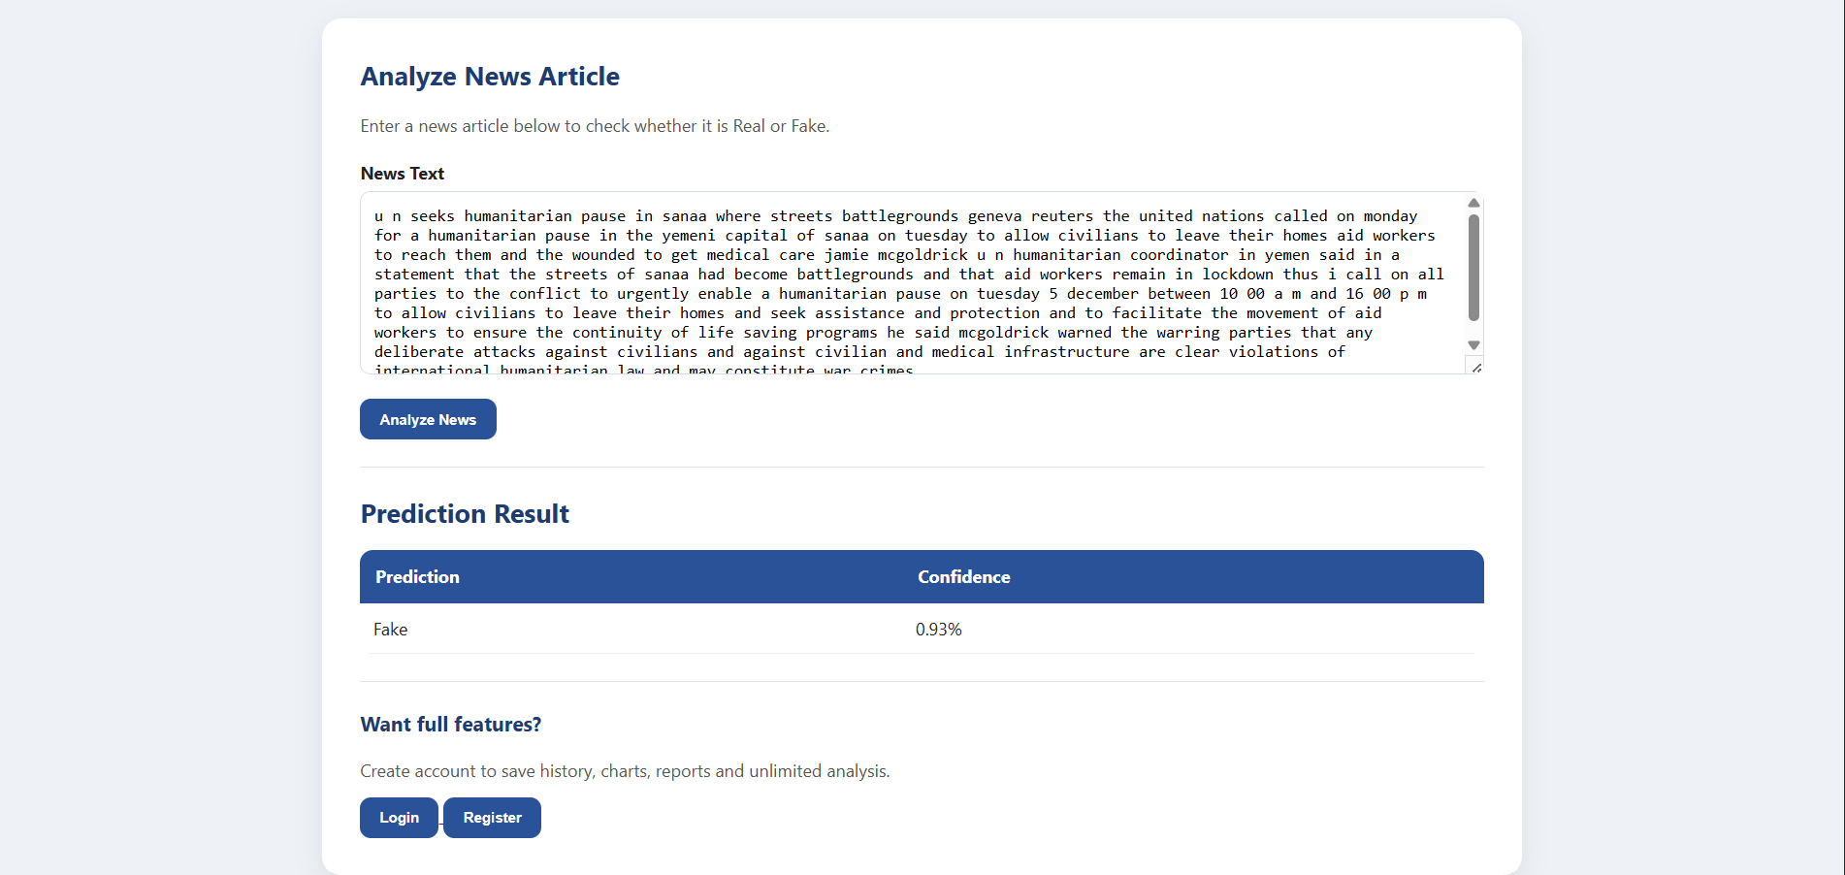
User Interfaces
Try Demo Page (on provided test data)

Slide 35
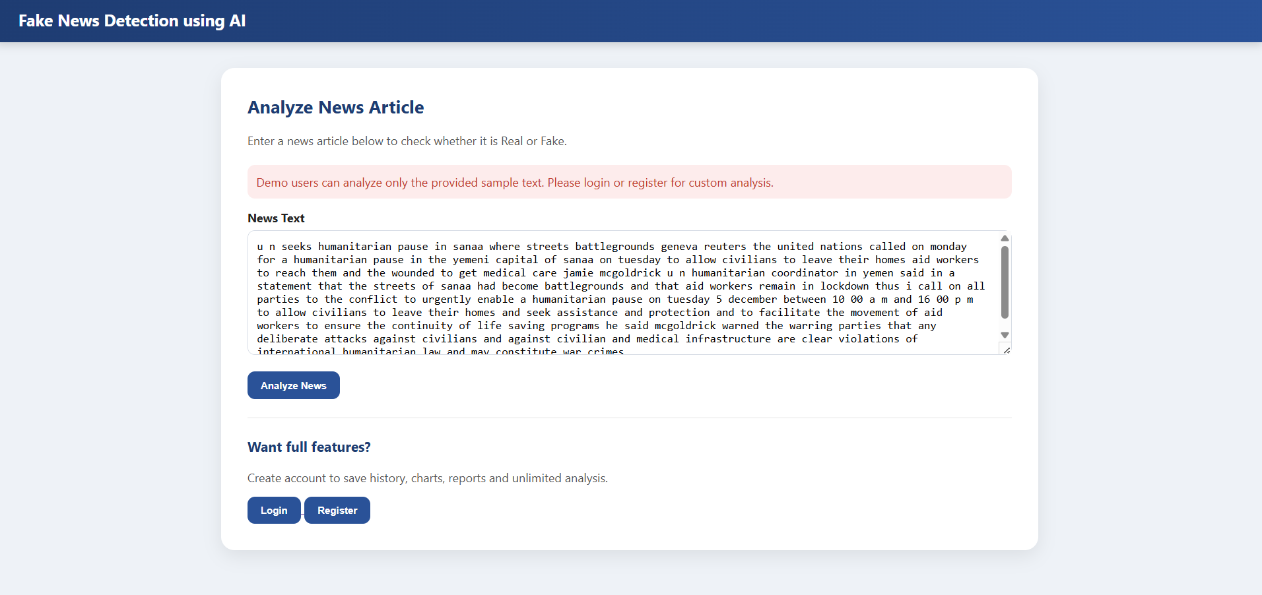
User Interfaces
Try Demo Page (on user provided custom news data)

Slide 36
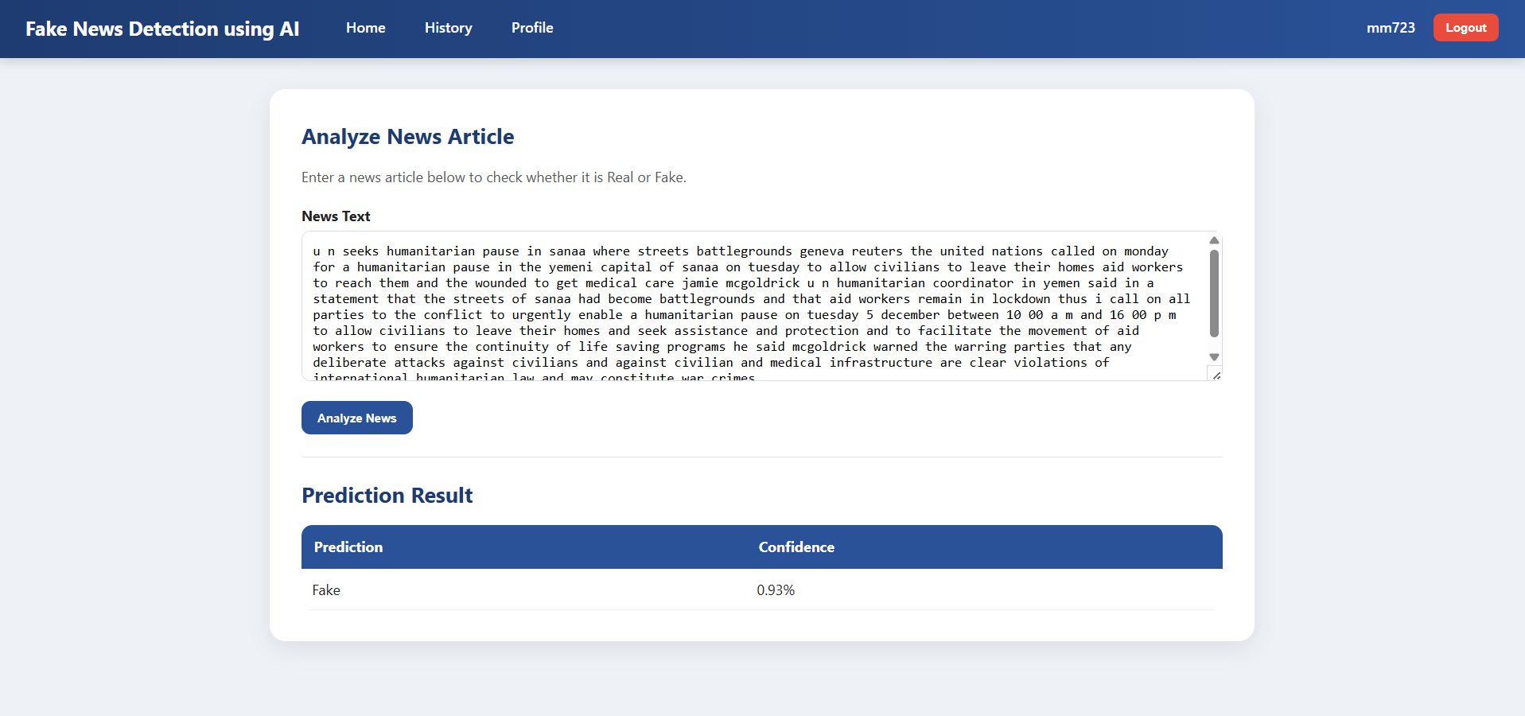
User Interfaces
Home page of registered user (with news analysis result)

Slide 37
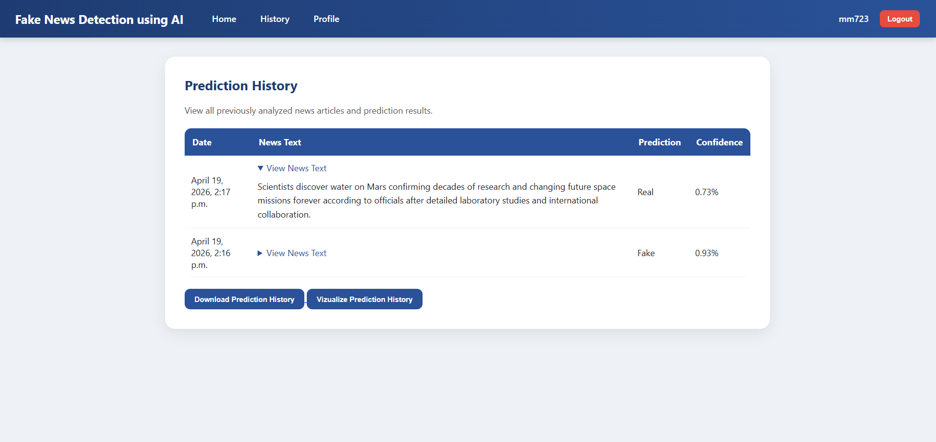
User Interfaces
Prediction history page of registered user

Slide 38
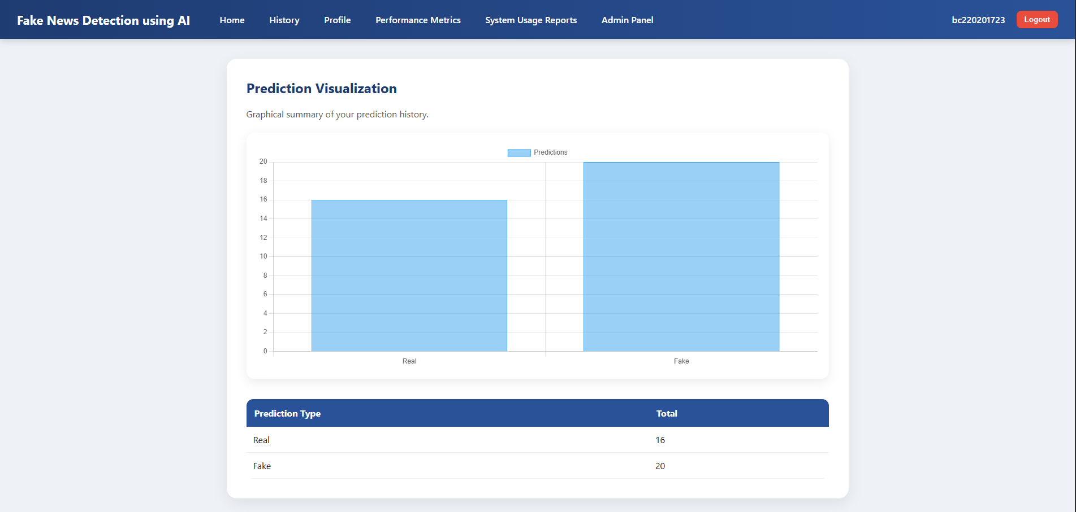
User Interfaces
History chart page to visualize the prediction history

Slide 39
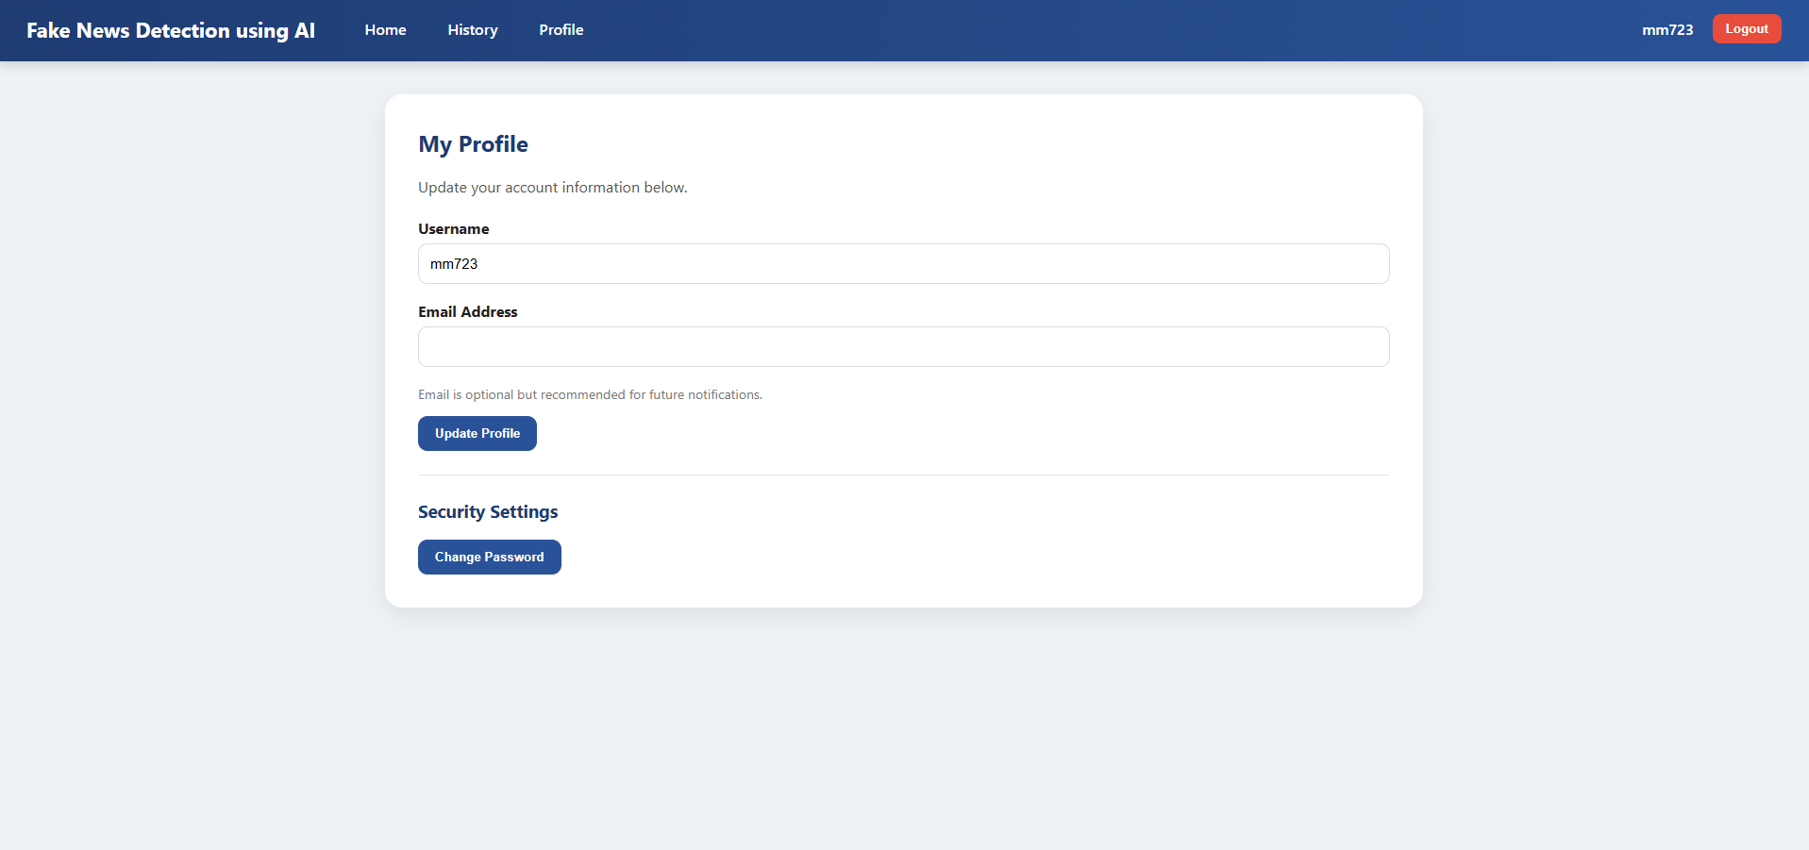
User Interfaces
Profile setting page (for changing username and password)

Slide 40
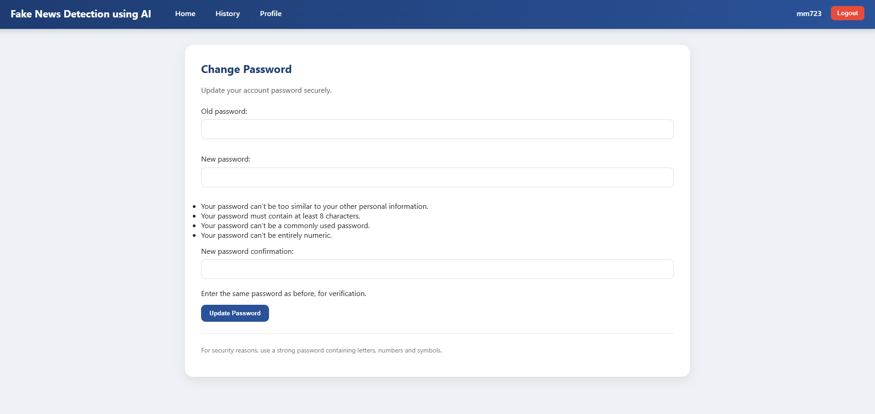
User Interfaces
Change password page

Slide 41
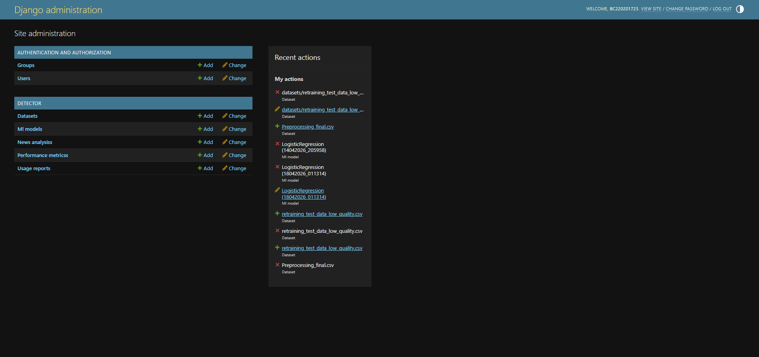
User Interfaces
Admin panel page

Slide 42
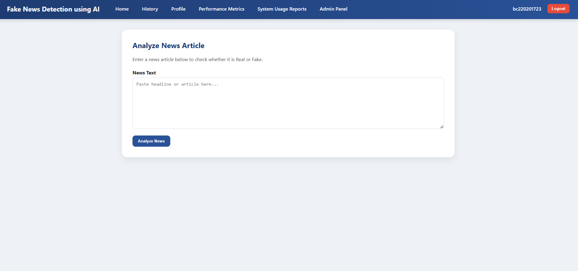
User Interfaces
Admin home page

Slide 43
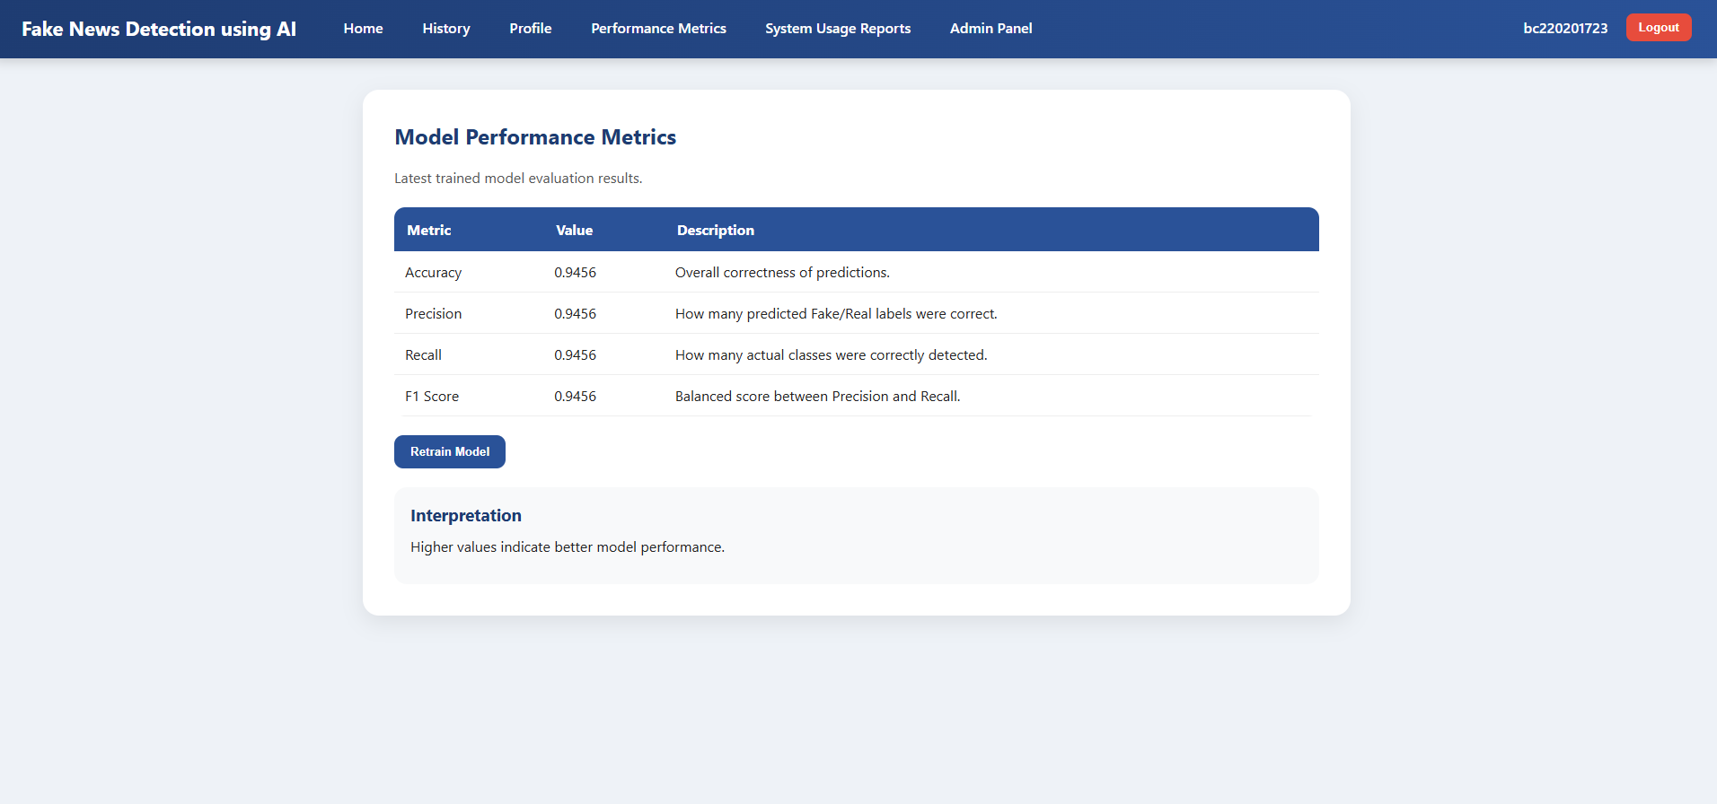
User Interfaces
Admin performance metrics page (with Retrain Model button)

Slide 44
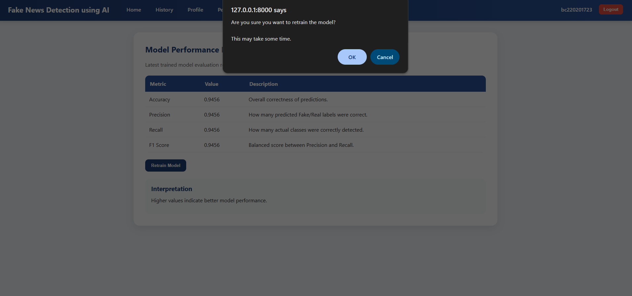
User Interfaces
Admin performance metrics page (when Retrain Model button is clicked)

Slide 45
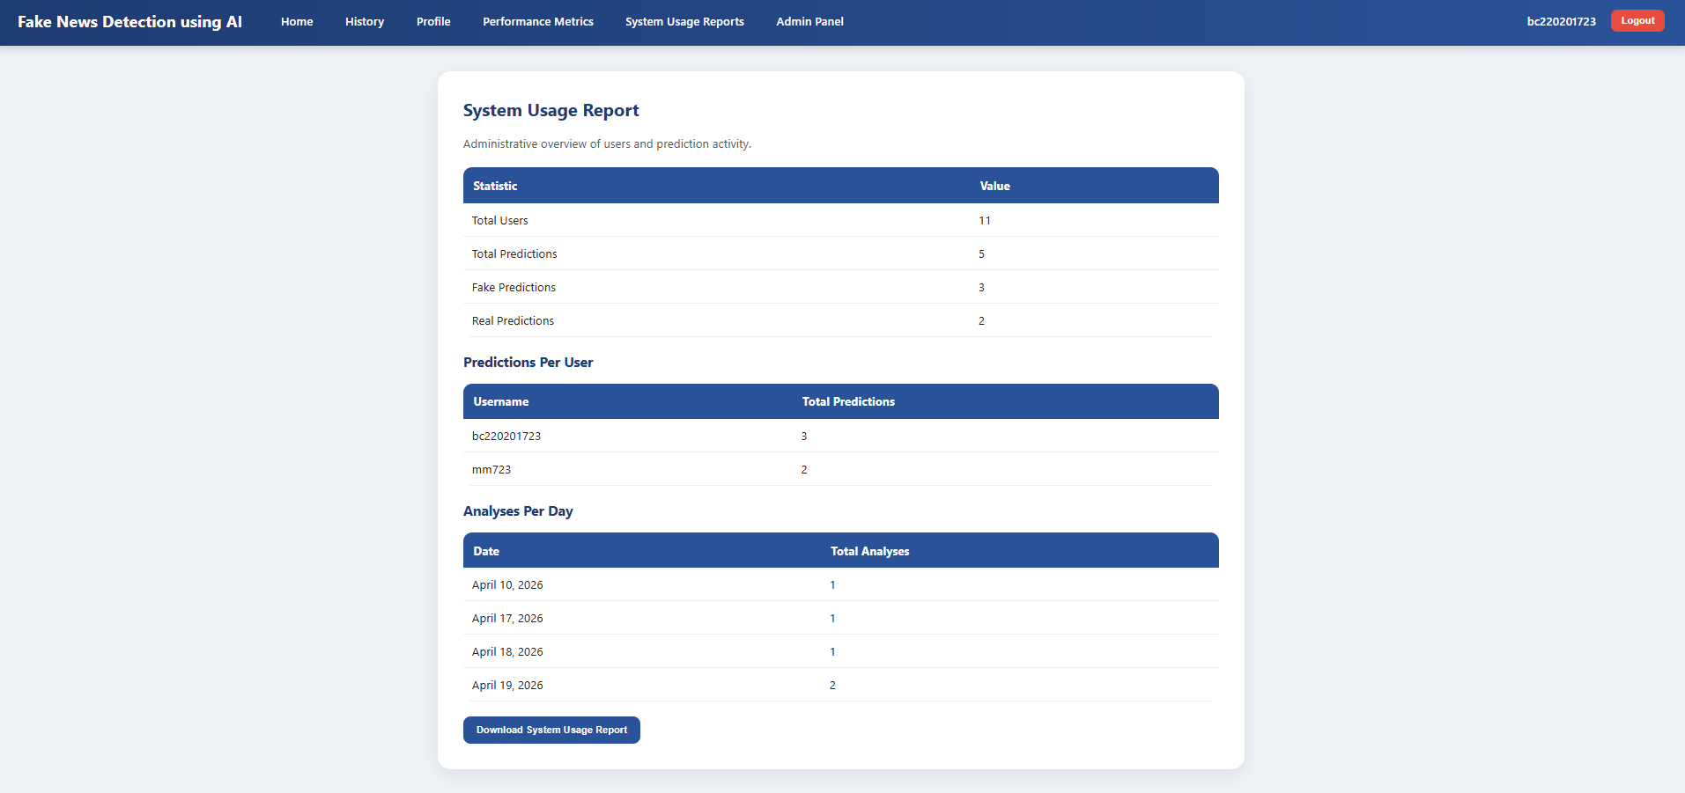
User Interfaces
Total system usage report page

Slide 46
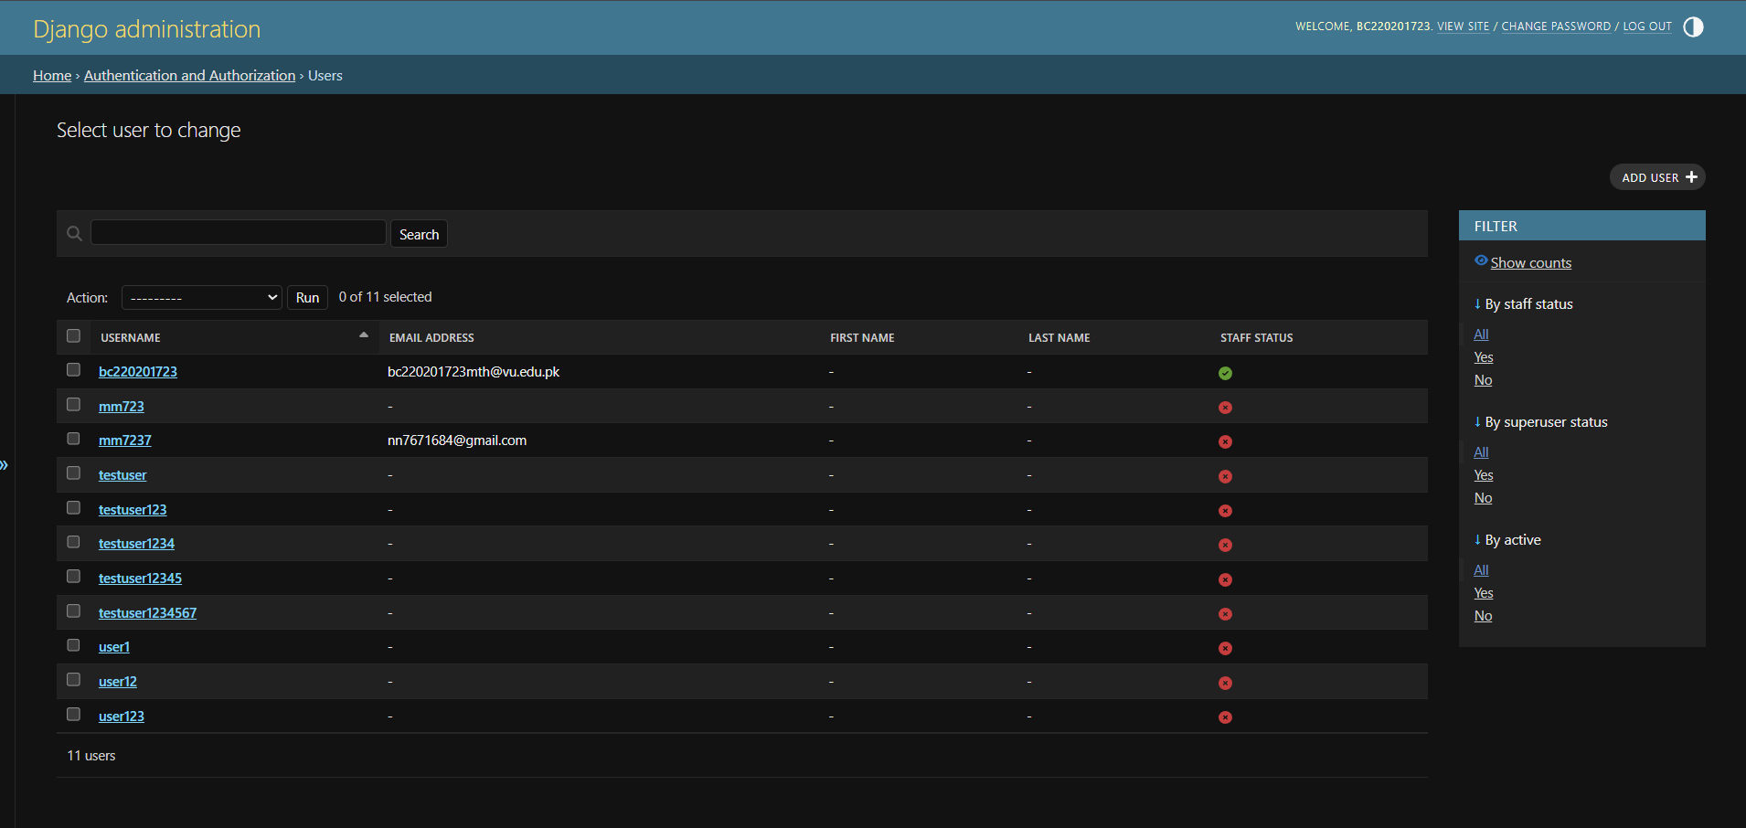
User Interfaces
User Management page (in admin panel)

Slide 47
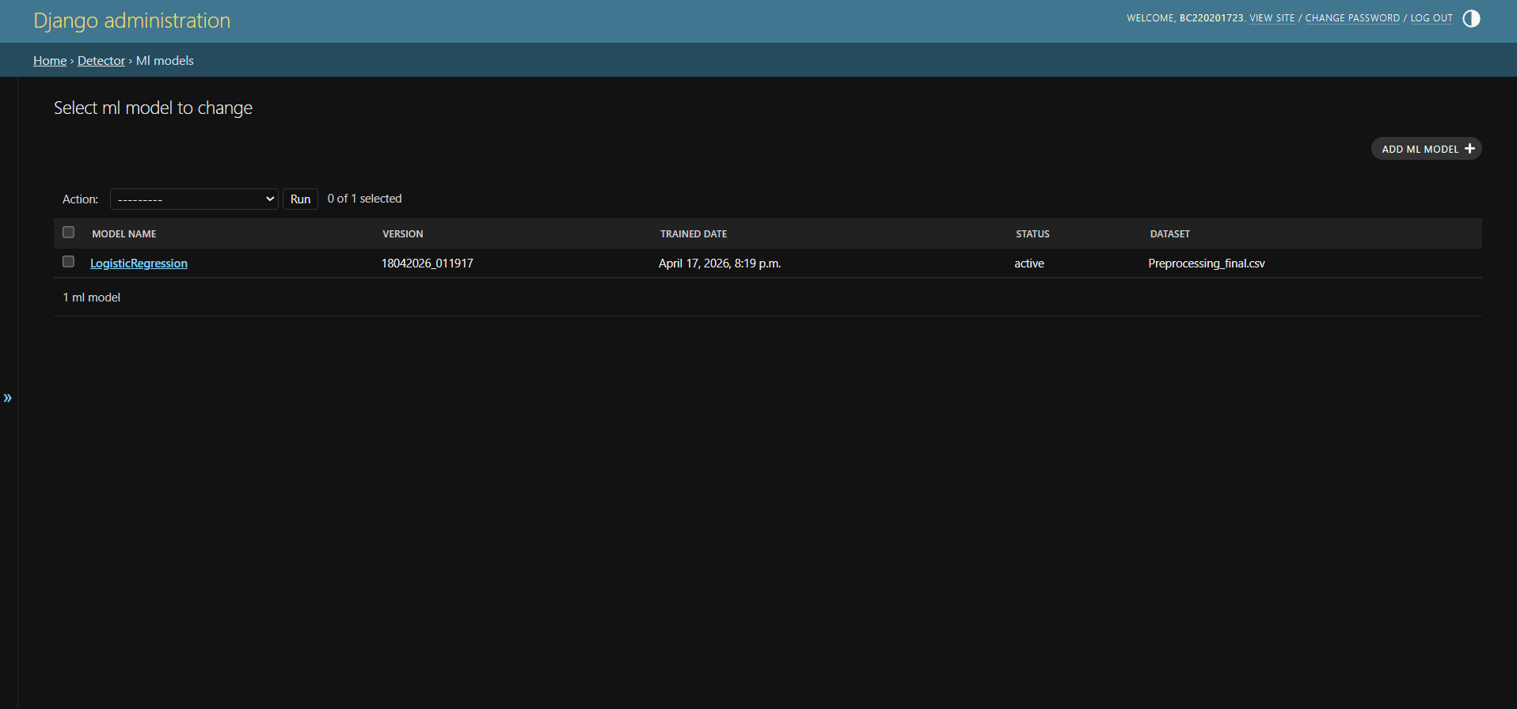
User Interfaces
ML model page (for model details and advance configurations)

Slide 48
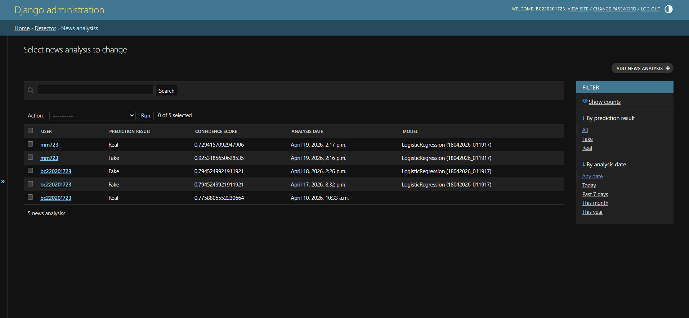
User Interfaces
News analysis management page (in admin panel)

Slide 49
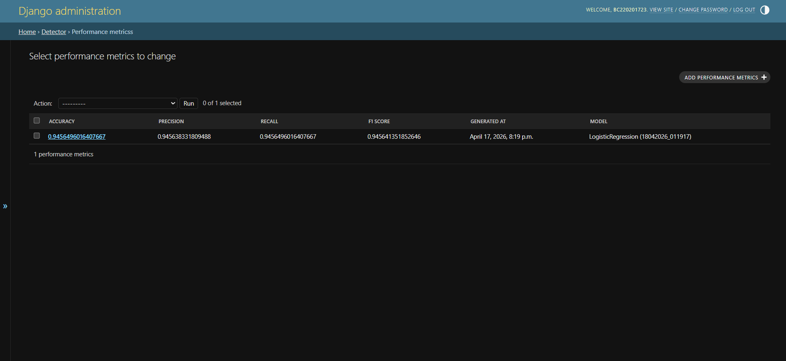
User Interfaces
Detailed system performance metrics (in admin panel)

Slide 50
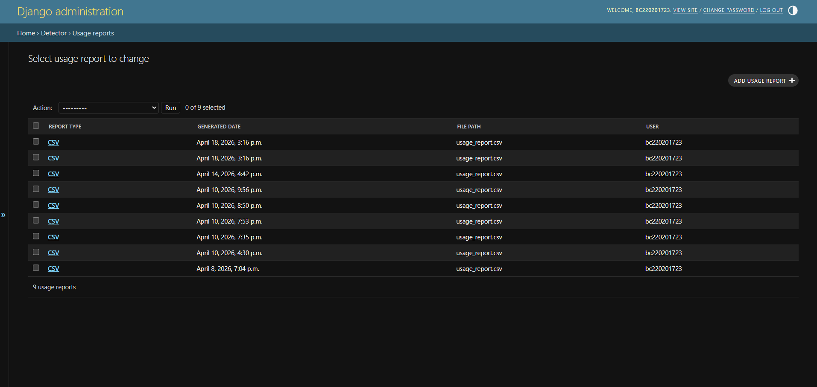
User Interfaces
System usage report download history (in admin panel)

Slide 51
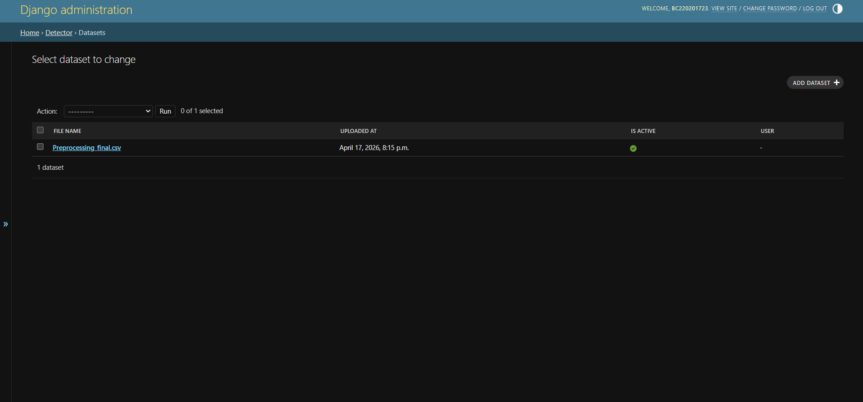
User Interfaces
Dataset management page (in admin panel)

Slide 52
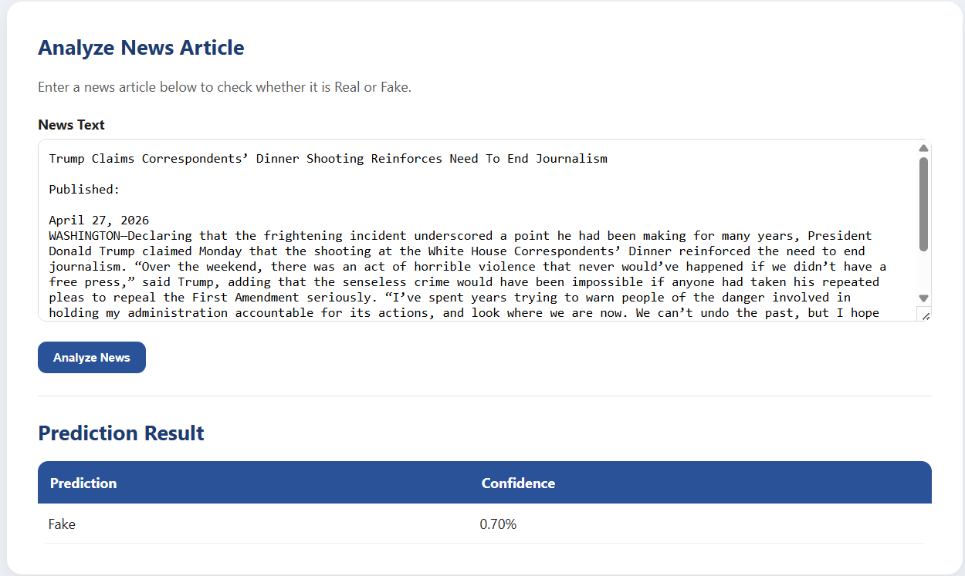
System Demonstration
Example 1:
Trump Claims Correspondents’ Dinner Shooting Reinforces Need To End Journalism.
https://theonion.com/trump-claims-correspondents-dinner-shooting-reinforces-need-to-end-journalism/

Slide 53
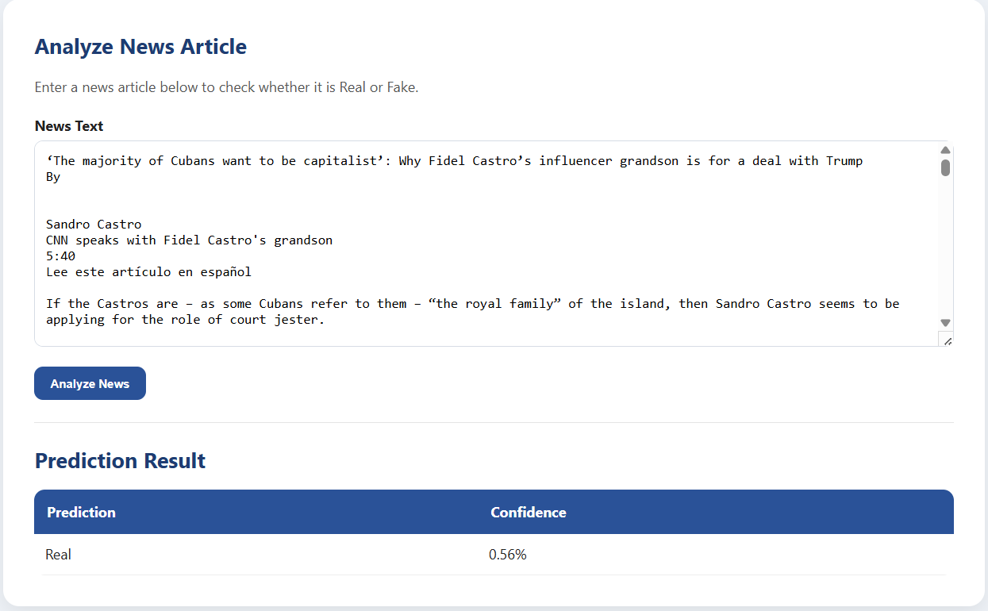
Example 2:
‘The majority of Cubans want to be capitalist’: Why Fidel Castro’s influencer grandson is for a deal with Trump
https://edition.cnn.com/2026/03/30/americas/cuba-sandro-castro-interview-latam-intl

Slide 54
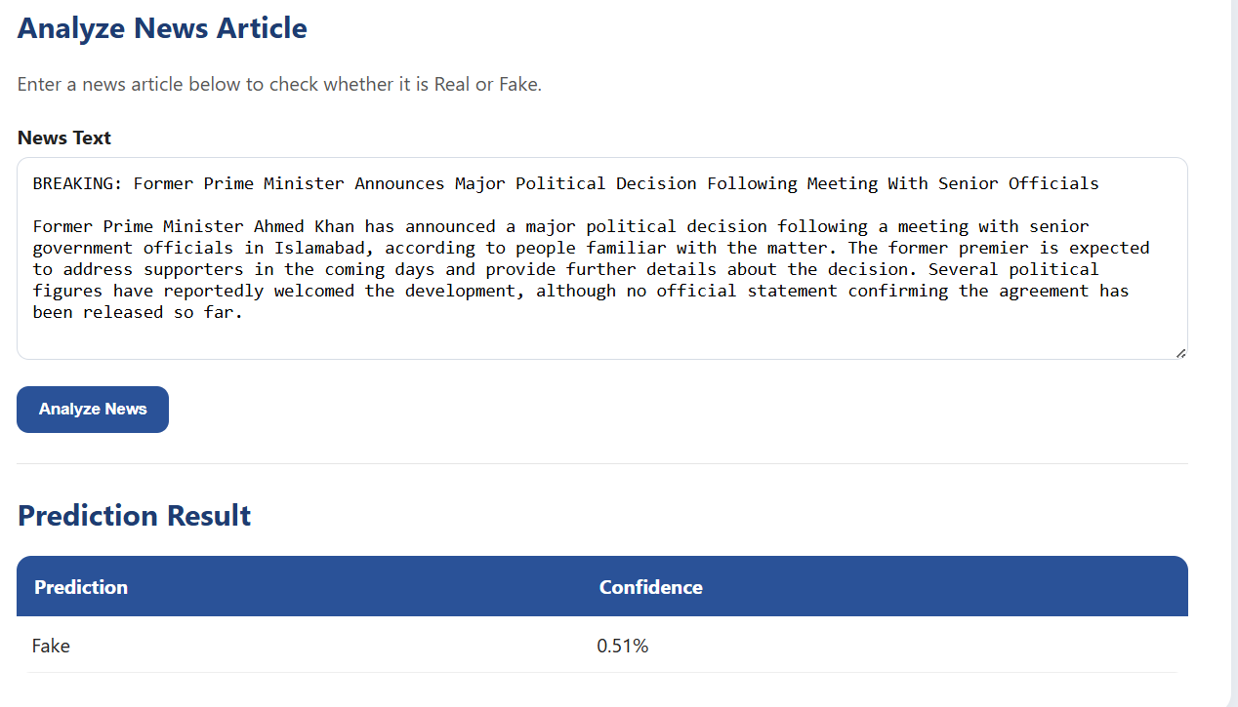
Example 3:
BREAKING: Former Prime Minister Announces Major Political Decision Following Meeting With Senior Officials

Slide 55
Machine Learning Approach
Algorithm: Logistic Regression
Feature Extraction: TF-IDF
Dataset Size: 84,950 records
Preprocessing:
Cleaning
Stopword Removal
Lemmatization
Duplicate Removal
Reason for choosing Logistic Regression:
Fast and Lightweight model with respect to hardware.
Efficient in terms of Training time and Runtime complexity
High accuracy
Easy deployment and integration with Django

Slide 56
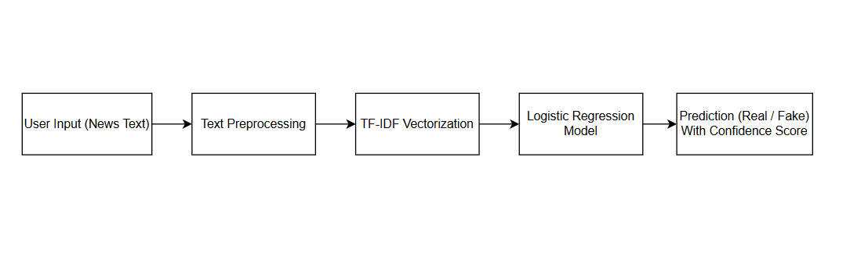
System Workflow

Slide 57
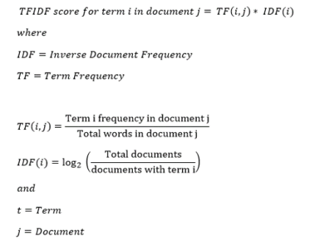
Machine Learning Approach

Slide 58
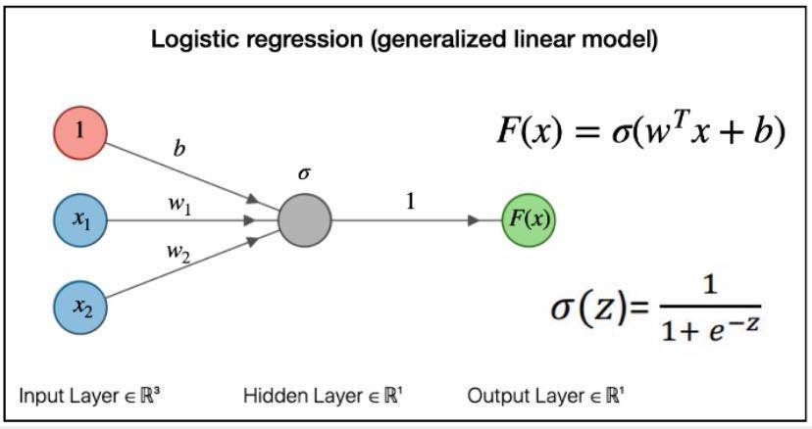
Machine Learning Approach

Slide 59
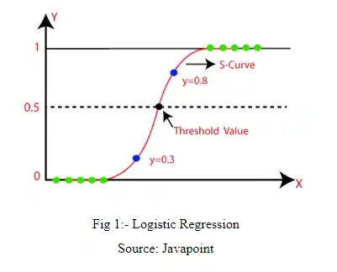
Machine Learning Approach

Slide 60
Model Performance
Accuracy = 91.44%
Precision = 91.55%
Recall = 91.44%
F1 Score = 91.42%
Dataset Size: 84,950 (After Cleaning and Preprocessing)

Slide 61
Data Preprocessing
Missing values handled
Title + text combined
Lowercasing
URL & HTML removal
Stopword removal
Lemmatization
Duplicate removal
And some other preprocessing steps

Slide 62
Challenges Faced:
Dataset quality issues.
Lack of local datasets related to Pakistan.
Machine Learning model integration with Django.
Implementing retraining feature in Django.

Slide 63
Future Enhancements
Using more advanced techniques such as Deep learning (BERT) created by Google
By using Pakistan-specific dataset.
Developing Mobile application version of the system.
Cloud deployment to make the system more accessible.
Automated retraining (MLOps)

